Slide 1
STAGE-DEV Model
Dr. Hasan Dudu
European Commssion – Joint Research Center

Slide 2
JRC: Function and mission
The Joint Research Centre provides EU Institutions and Member States with scientific analysis and advice.
JRC mission is to play a central role in creating, managing and making sense of the collective scientific knowledge for better EU policy.

Slide 3
JRC: Quick Facts
Established 1957
7 institutes in 5 countries
3000 technical and administrative personnel
1 200 contributions to EU Policy
684 peer-reviewed scientific publications in 2013
Budget: €400 million annually

Slide 4
TS4FNS
Macro analysis (national and regional economic systems)
Support agricultural data retrieval (DATAM)
Micro analysis (farm models)
Meta-analysis of best-practice for a sustainable agriculture
Drivers of demand for agricultural products
Scientific partnerships and networks
Analysis of CAP impacts on developing countries

Slide 5
Macro Analysis
Ex ante policy analysis (EU and national):
Agricultural inputs & investments programs
Infrastructure investments
Education & Health
Social protection
Trade (tariffs, non-tariffs, etc.) & Food aid
Rural development programs/policies
Others (national specific)
+ Impact of EU policies on African regions (e.g., CAP)

Slide 6
What we do?
2014-2019+
Support stakeholders to do CGE analysis for current policy issues
Create a CGE model tailored for developing country context
Create SAM and other data bases required
Make ad-hoc analysis on demand
Two-way knowledge transfer
Funded by: EC-DG Development and Cooperation

Slide 7
JRC Current Activities
Kenya
Support for the strategic investment plan (in coop. with FAO)
Senegal
Support for the fiscal policy reform
Support for the new investment programme 2018-2023 for «Plan emergent Senegal 2035» (in coop. with FAO)
Knowledge transfer activities
Ethiopia
Support to EDRI to develop a new SAM with a new IO & CGE model to support Development Plan
Support to PSRC (knowledge transfer ? )
Workshop in November on CGE modelling (in cooperation with EEA)

Slide 8
Home Production for Home Consumption (non-separability) and nested CES/LES (two level utility nesting)
Labour market
un/under-employment with labor supply decision
Migration
Segmentation
Endogenous distribution of factor income
Several types of investments linked to different capital types
Recursive dynamic version with benchmarking to GDP, investment etc…
Human capital
Exclusive population accounting (birth & death rates)
Food Security indicators
Flexible CES Nestining

Slide 9
The Code
Coding is based on
Efficiency
Developing conventions
End users in mind
Relatively easy to use, harder to develop on
Many advanced coding tehcniques (globals etc…)
Many debugging tools
Extensive code recycling (WET vs. DRY coding)

Slide 10
What is next?
Workshop in November
Training in 2018 in Addis Ababa
If institutional request from EUD & the study will support a policy document:
Joint Project & Joint work in Seville - Spain paid by EC
Further training in USA paid by EC
Autnomous studies with ad-hoc support
Model is yours!

Slide 11
Let’s be honest!
CGE for consultancy work
Objective
Run simulations
Write policy report
You need to
Use GAMS at intermediate level
Understand the results & main drivers
Takes 6-12 months (=2000 hours)
You will be a good policy analyst
BUT dependent on the CGE modeller
CGE for Academic work
Objective
Make novel contribution
Publishacademic papers
You need to
Use GAMS at advanced level
Understand the whole system
Takes 4-5 years (= 10000 hours)
You will be A CGE modeller
BUT dependent on the policy analyst

Slide 12
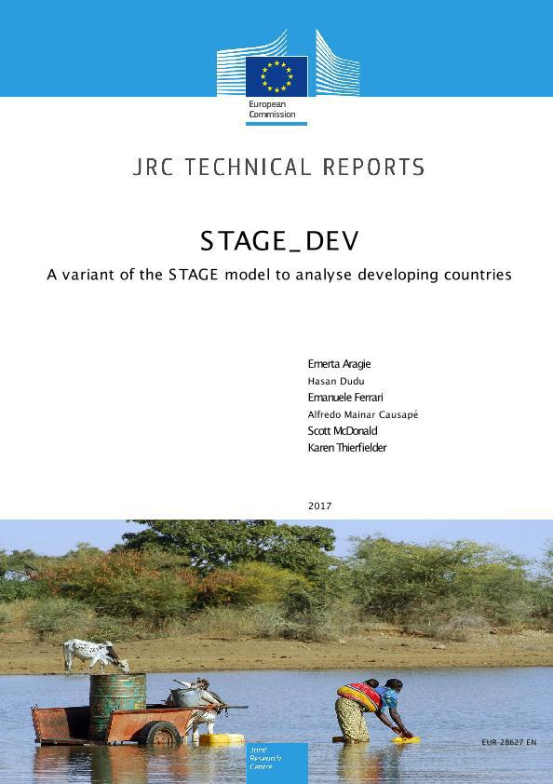
Resources:
StageDEV documentation: https://ec.europa.eu/jrc/en/publication/stagedev-variant-stage-model-analyse-developing-countries
Stage home page: http://www.cgemod.org.uk/
CGEBox website: http://www.ilr.uni-bonn.de/em/rsrch/cgebox/cgebox_e.htm
PEP Network: https://www.pep-net.org/pep-standard-cge-models
AGRODEP: http://www.agrodep.org/model/miragrodep-model

Slide 13
Contact Info
Dr. Hasan Dudu
Scientific Project Officer
European Commission - DG Joint Research Center
Sustainable Resources Directorate
Seville, Spain Tel: +34 954-488417
Email: hasan.dudu@europa.eu.ec

